Slide 1
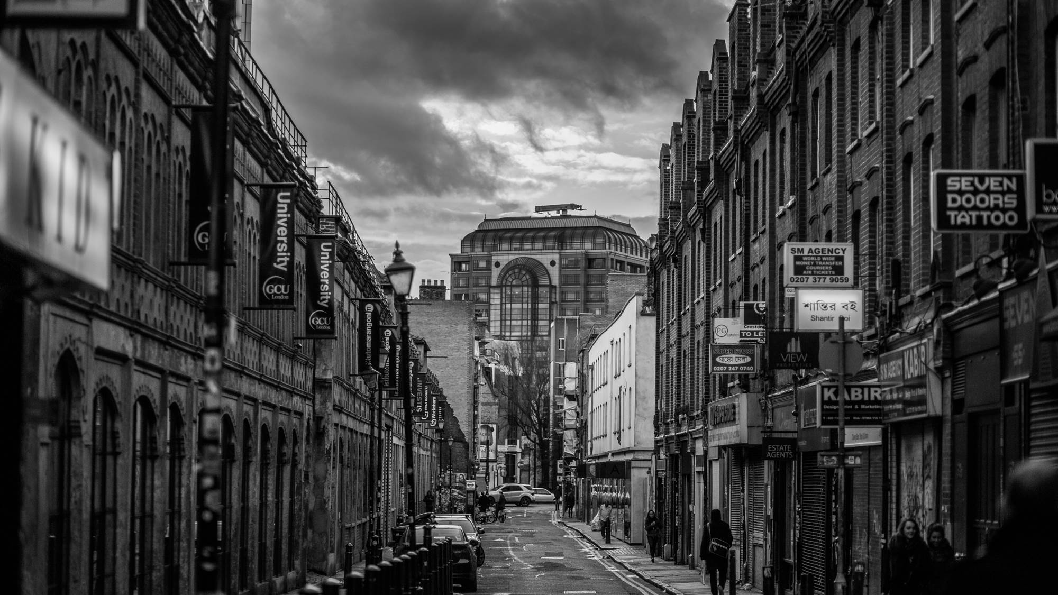
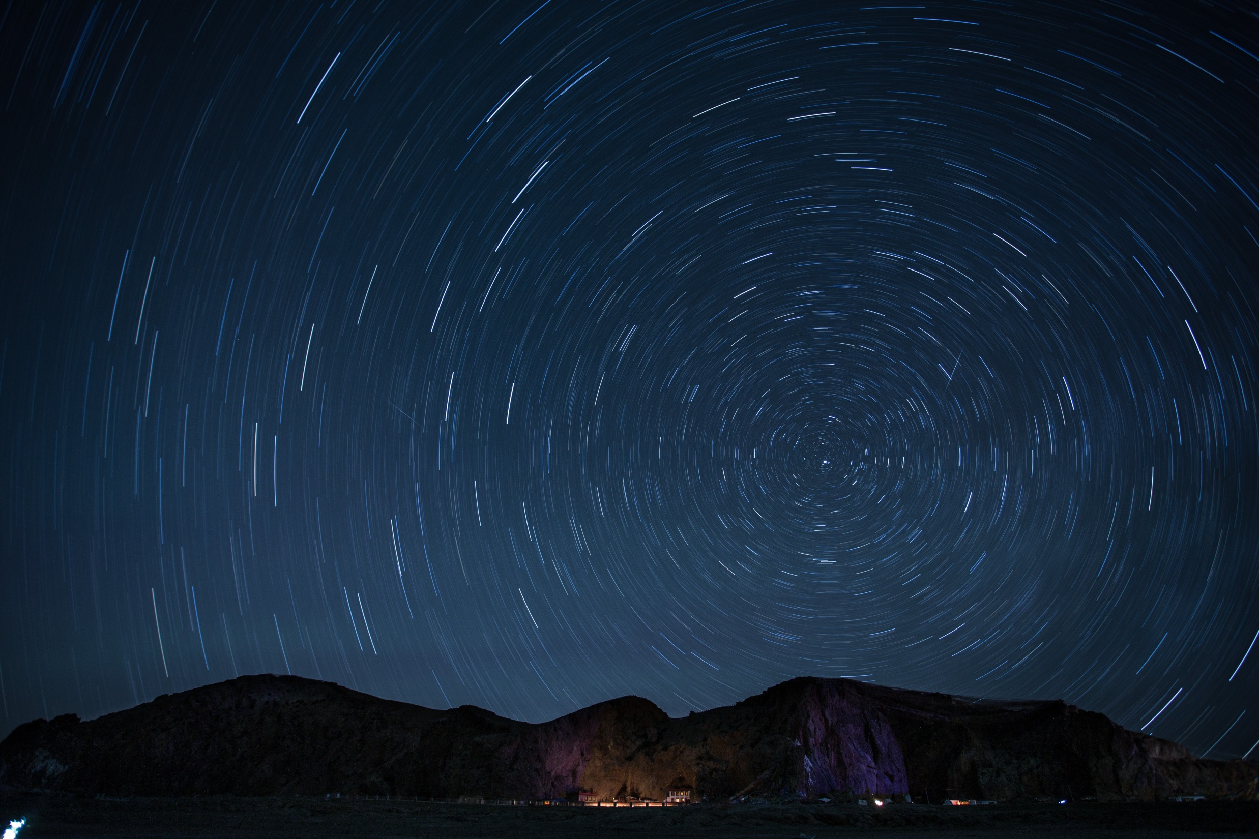
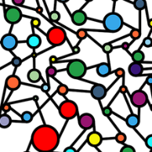
Exploratory Data Analysis
2018. 09. 19
JiSWU
Team Member
Kiwon Seo | Jihye Lee

Slide 2
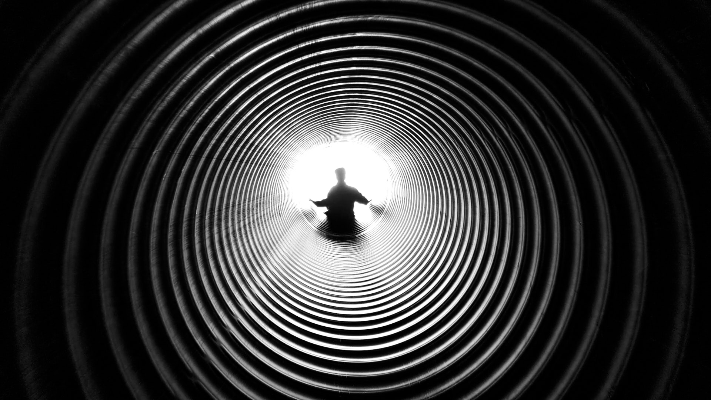


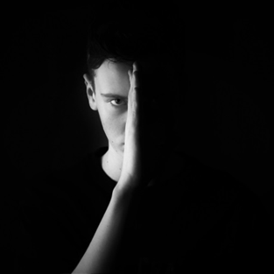
JiSWU
INDEX
ROJECT DESCRPITION
DATA
DICOM FILES AND MEDICAL IMAGE
EXPLORING THE DATA AND LABLES

Slide 3
JiSWU
01
PROJECT
DESCRIPTION

Slide 4
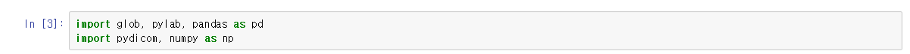

JiSWU
PROJECT DESCRIPTION
In this competition, the primary endpoint will be the detection of bounding boxes corresponding to the diagnosis of pneumonia (e.g. lung infection) on chest radiographs, a special 2D high resolution grayscale medical image. Note that pnuemonia is just one of many possible disease processes that can occur on a chest radiograph, and that any given single image may contain 0, 1 or many boxes corresponding to possible pneumonia locations.

Slide 5
JiSWU
02
DATA

Slide 6
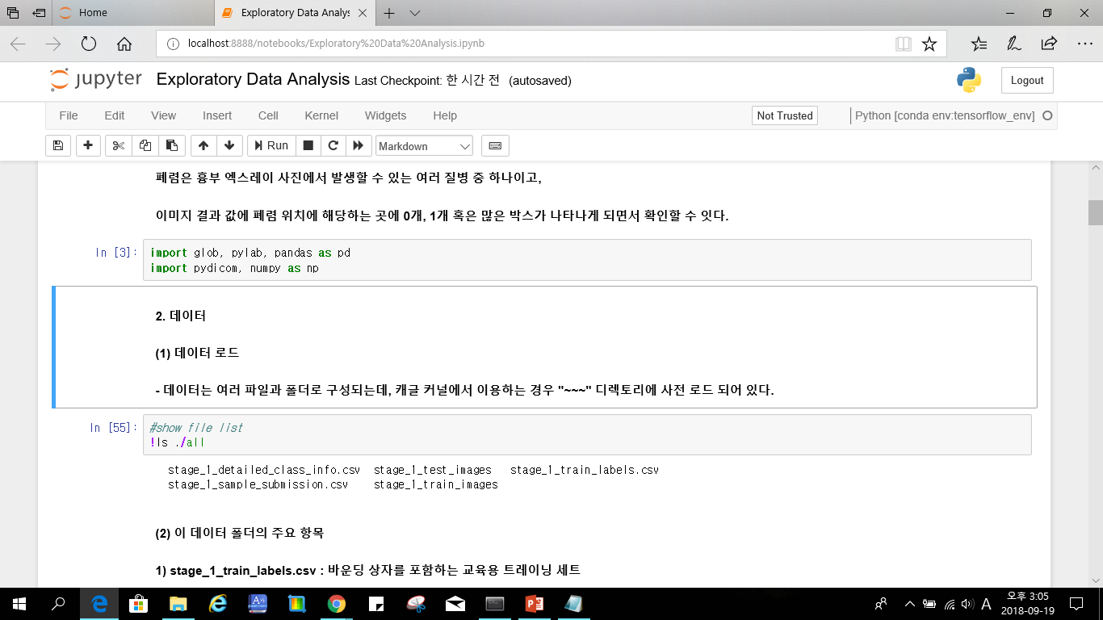
JiSWU
DATA
The challenge data is organized in several files and folders. If you are following along in the
Kaggle kernel, this data will be preloaded in the ../input directory:
The several key items in this folder:
stage_1_train_labels.csv: CSV file containing training set patientIds and labels (including bounding boxes)
stage_1_detailed_class_info.csv: CSV file containing detailed labels (explored further below)
stage_1_train_images/: directory containing training set raw image (DICOM) files

Slide 7
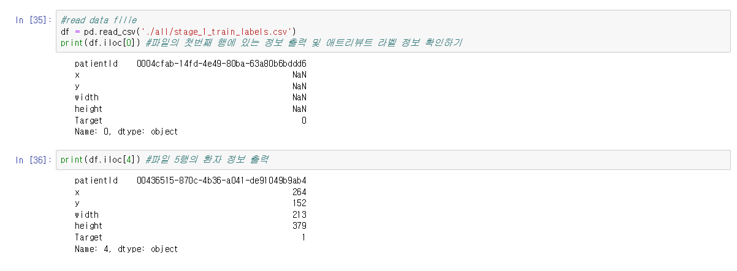
JiSWU
DATA

Slide 8
JiSWU
03
DICOM FILES AND
MEDICAL IMAGES

Slide 9
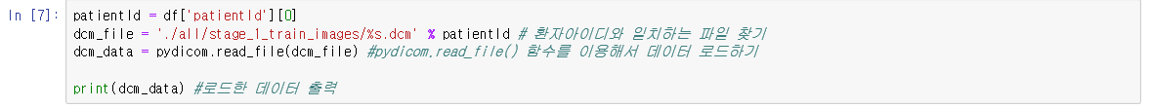
JiSWU
DICOM FILES AND MEDICAL IMAGES
Medical images are stored in a special format known as DICOM files (*.dcm). They contain a combination
of header metadata as well as underlying raw image arrays for pixel data. In Python, one popular library
to access and manipulate DICOM files is the pydicom module. To use the pydicom library, first find the
DICOM file for a given patientId by simply looking for the matching file in the stage_1_train_images/ folder,
and the use the pydicom.read_file()method to load the data:

Slide 10
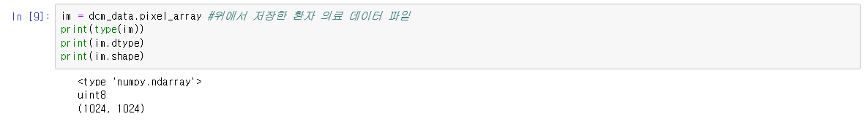
JiSWU
DICOM FILES AND MEDICAL IMAGES
Most of the standard headers containing patient identifable information have been anonymized (removed) so we are left with a relatively sparse set of metadata. The primary field we will be accessing is the underlying pixel data as follows:

Slide 11
JiSWU
DICOM FILES AND MEDICAL IMAGES
The relatively high dynamic range, high bit-depth original images have been rescaled to 8-bit encoding (256 grayscales). For the radiologists out there, this means that the images have been windowed and leveled already.
The relativley large original image matrices (typically acquired at >2000 x 2000) have been resized to the data-science friendly shape of 1024 x 1024.

Slide 12
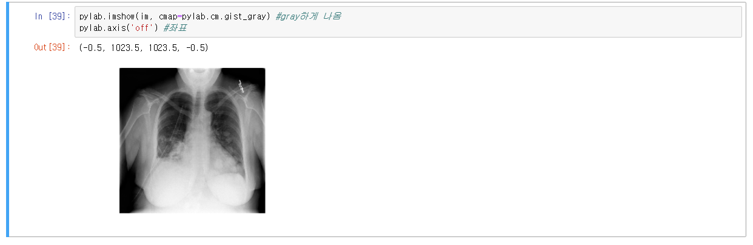
JiSWU
DICOM FILES AND MEDICAL IMAGES
To take a look at this first DICOM image, let's use the pylab.imshow() method

Slide 13
JiSWU
04
EXPLORING THE
DATA AND LABLES

Slide 14
JiSWU
EXPLORING THE DATA AND LABLES
As alluded to above, any given patient may potentially have many boxes if there are several different suspicious areas of pneumonia. To collapse the current CSV file dataframe into a dictionary with unique entries, consider the following method:

Slide 15
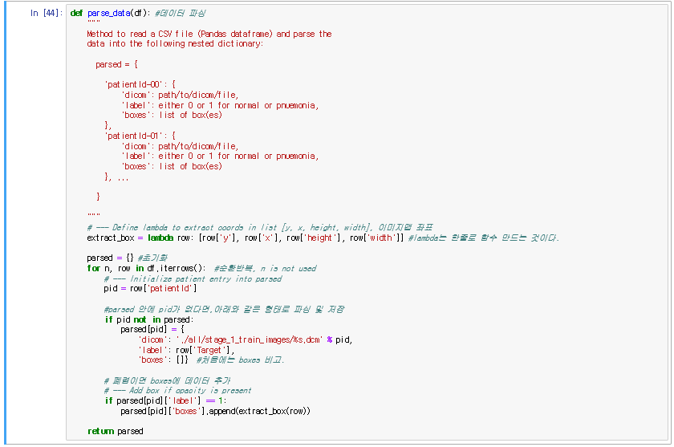
JiSWU
EXPLORING THE DATA AND LABLES

Slide 16
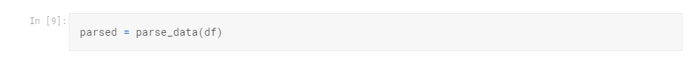
JiSWU
EXPLORING THE DATA AND LABLES
Let's use the method here:

Slide 17
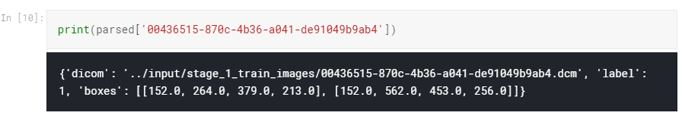
JiSWU
EXPLORING THE DATA AND LABLES
As we saw above, patient 00436515-870c-4b36-a041-de91049b9ab4 has pnuemonia so lets check our
new parseddict here to see the patients corresponding bounding boxes:

Slide 18
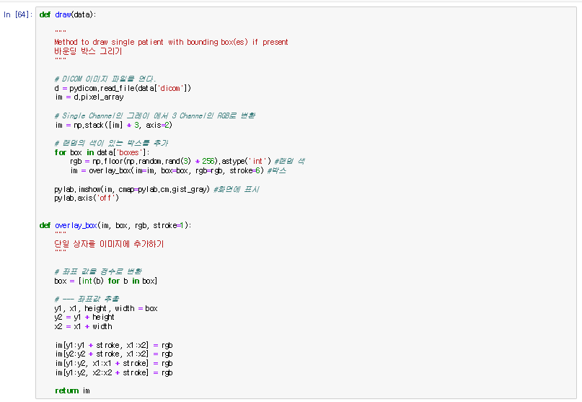
JiSWU
EXPLORING THE DATA AND LABLES

Slide 19
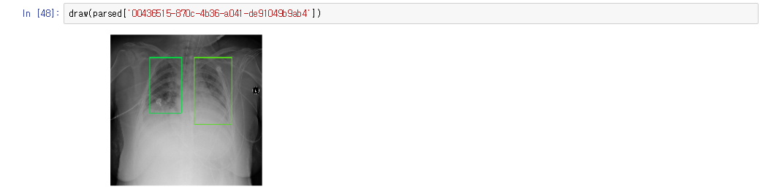
JiSWU
EXPLORING THE DATA AND LABLES

Slide 20
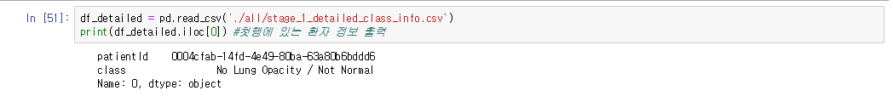
JiSWU
EXPLORING THE DATA AND LABLES
Exploring Detailed Labels
In this challenge, the primary endpoint will be the detection of bounding boxes consisting of a binary classification---e.g. the presence or absence of pneumonia. However, in addition to the binary classification, each bounding box withoutpneumonia is further categorized into normal or no lung opacity / not normal. This extra third class indicates that while pneumonia was determined not to be present, there was nonetheless some type of abnormality on the image---and oftentimes this finding may mimic the appearance of true pneumonia. Keep in mind that this extra class is provided as supplemental information to help improve algorithm accuracy if needed; generation of this separate class will not be a formal metric used to evaluate performance in this competition.

Slide 21
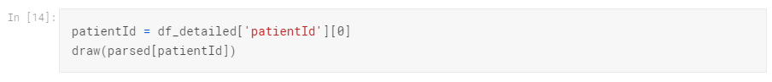
JiSWU
EXPLORING THE DATA AND LABLES
While the image displayed inline within the notebook is small, as a radiologist it is evident that the patient has several well circumscribed nodular densities in the left lung (right side of image). In addition there is a large chest tube in the right lung (left side of the image) which has been placed to drain fluid accumulation (e.g. pleural effusion) at the right lung base that also demonstrates overlying patchy densities (e.g. possibly atelectasis or partial lung collapse).
As you can see, there are a number of abnormalities on the image, and the determination that none of these findings correlate to pneumonia is somewhat subjective even among expert physicians. Therefore, as is almost always the case in medical imaging datasets, the provided ground-truth labels are far from 100% objective. Keep this in mind as you develop your algorithm, and consider consultation with a radiologist physician to help determine an optimal strategy for mitigating these discrepencies.

Slide 22
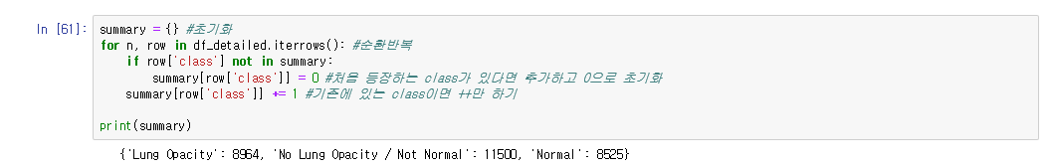
JiSWU
EXPLORING THE DATA AND LABLES
Label Summary
Finally, let us take a closer look at the distribution of labels in the dataset. To do so we will first parse the detailed label information:
As we can see, there is a relatively even split between the three classes, with nearly 2/3rd of the data comprising of no pneumonia (either completely normal or no lung opacity / not normal). Compared to most medical imaging datasets, where the prevalence of disease is quite low, this dataset has been significantly enriched with pathology.

Slide 23
Team Project
JiSWU
THANK YOU

